Slide 1

UNIVERSITY INSTITUTE OF ENGINEERING
COMPUTER SCIENCE ENGINEERING
Master of Engineering
ADVANCED DATA STRUCTURES
&
ALGORITHMS
(23CSH-622)
INTRODUCTION
DISCOVER . LEARN . EMPOWER

Slide 2

ADVANCED DATA STRUCTURES
&
ALGORITHMS
(23CSH-622)
By : Dr. Ranjit Singh (E10947)
www. cuchd.in Campus : Gharaun, Mohali

Slide 3
LINK LIST
Course Outcome
Will be covered in this lecture
CO Number | Title | Level
CO1 | To understand role of algorithms in science and practice of computing.. | Remember
CO2 | To gain familiarization with different algorithm design techniques. | Understand
CO3 | To apply different algorithm design techniques for solving engineering and related problems and study their performance. | Analysis and application

Slide 4
Syllabus/TOPICS TO BE COVERED
Link list definition
Application of Link List
Link List Advantages and disadvantages
Link list insertions at different positions
Link list deletion at different positions
Doubly Link List

Slide 5
LECTURE OBJECTIVES
Course objective is how to use link list data structures and their applications.
Student can easily create link list and able to perform all types of operation on link list.
Student will learn how doubly link list is better than singly link list.

Slide 6
LEARNING OUTCOMES
Students will learn about the link list data structures, their advantages over arrays and disadvantages.
Students can able to do the distinctions between arrays and link lists.
Students will learn about Link lists creations , all types of insertions and deletions in link lists.

Slide 7
Link Lists
A list implemented by each item having a link to the next item.
Each node consists of its own data and the address of the next node and forms a chain.
Linked Lists are used to create trees and graphs.

Slide 8
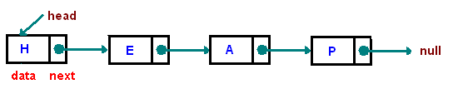
REPRESENTATIONS
[1]

Slide 9
Applications of Linked Lists
Linked Lists can be used to implement Stacks , Queues.
Linked Lists can also be used to implement Graphs. (Adjacency list representation of Graph).
Implementing Hash Tables
A polynomial can be represented in an array or in a linked list by simply storing the coefficient and exponent of each term.

Slide 10
ARRAYS VS LINKLISTS
Arrays
• have a pre-determined fixed size
• easy access to any element a[i] in constant time
• no space overhead
• Size = n x sizeof(element)
Linked lists
• no fixed size, grow one element at a time.
• space overhead
• each element must store an additional reference
• Size = n x sizeof (element) + n x sizeof(reference)
• no easy access to i-th element wrt the head of the list • need to hop through all previous elements

Slide 11
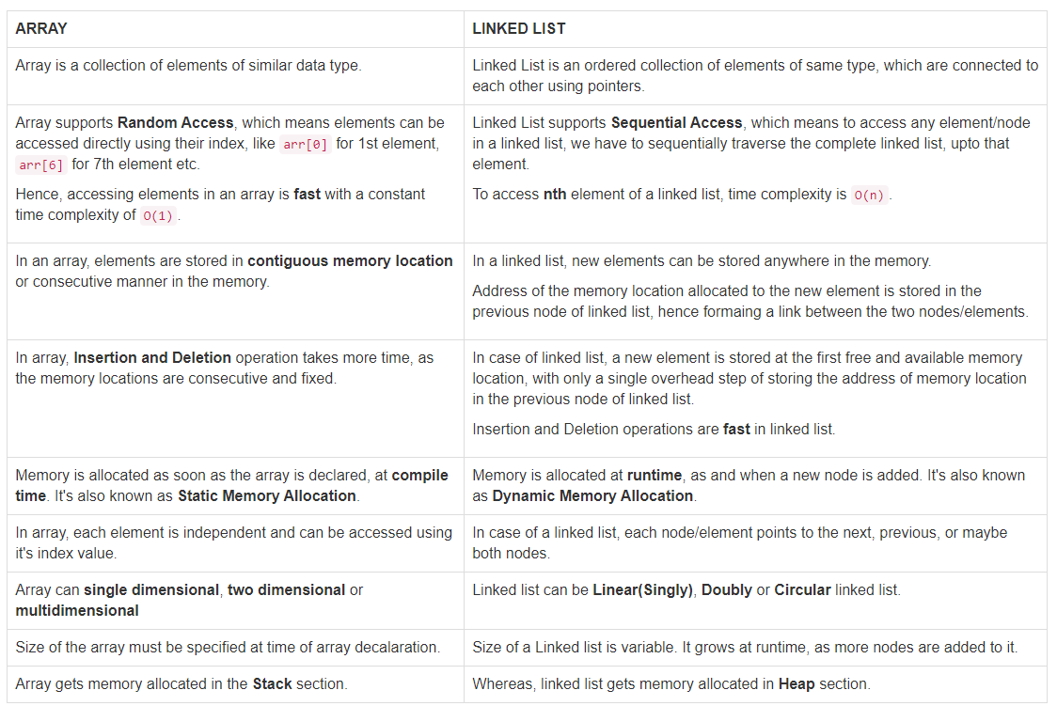
ARRAYS VS LINKLISTS

Slide 12
Types of Linked Lists
There are 3 different implementations of Linked List available, they are:
Singly Linked List
Doubly Linked List
Circular Linked List
Think : Why we need pointers in Linked List?

Slide 13
SINGLY LINK LIST
[1]

Slide 14
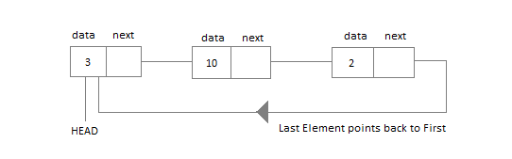
Circular Linked List
The last element stores the address of the starting element
Application of Circular Linked List
circular linked list is used is our Personal Computers, where multiple applications are running. All the running applications are kept in a circular linked list and the OS gives a fixed time slot to all for running. The Operating System keeps on iterating over the linked list until all the applications are completed.
Multiplayer games. All the Players are kept in a Circular Linked List and the pointer keeps on moving forward as a player's chance ends.

Slide 15
OPERATIONS ON LINK LIST
TRAVERSAL
SEARCHING (IN UNSORTED LINK LIST AND SORTED LINK LIST)
DELETION
INSERTION
AT THE BEGINNING
AFTER A GIVEN NODE
IN THE SORTED LIST

Slide 16
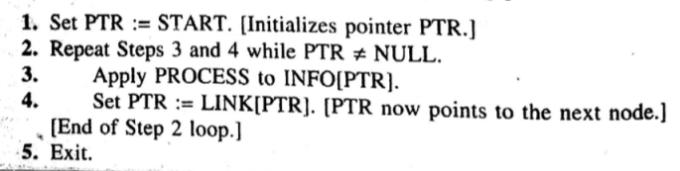
TRAVERSAL OF LINK LIST

Slide 17
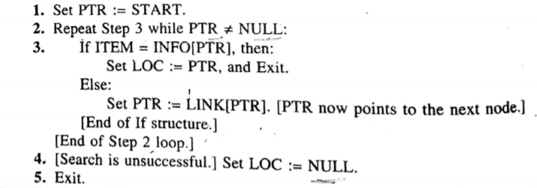
SEARCHING IN UNSORTED LINK LIST

Slide 18
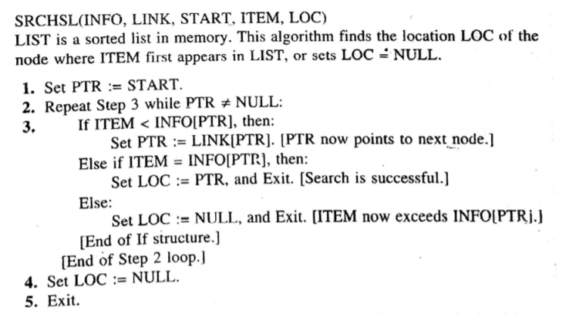
SEARCHING IN SORTED LINK LIST

Slide 19
CONCEPT OF GARBAGE COLLECTION
AVAIL LIST
UNDER FLOW
OVERFLOW

Slide 20
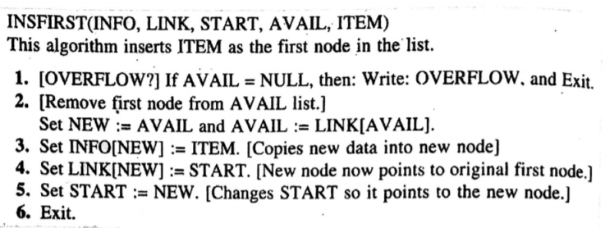
INSERTION IN LINK LIST-AT BEGINNING

Slide 21
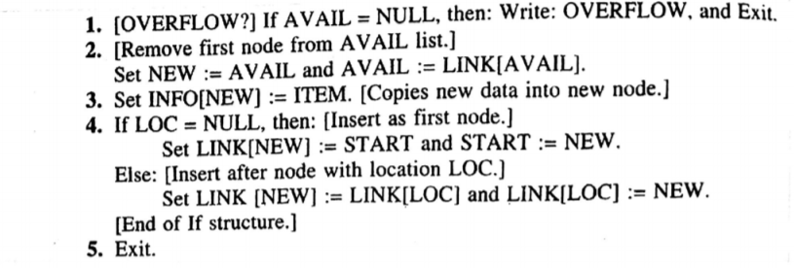
INSERTION IN LINK LIST-AFTER GIVEN LOC

Slide 22
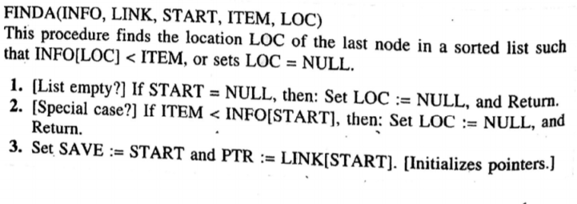
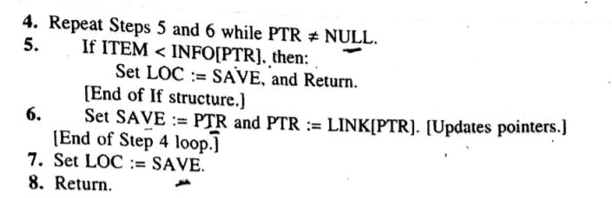
INSERTION IN LINK LIST-IN SORTED LIST

Slide 23
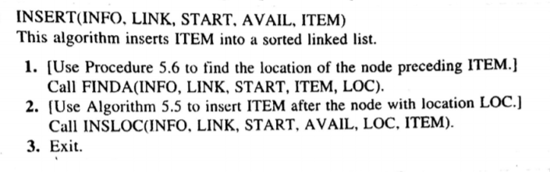
CONTINUED

Slide 24
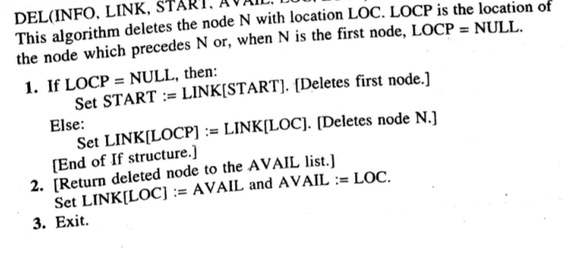
Deletion

Slide 25
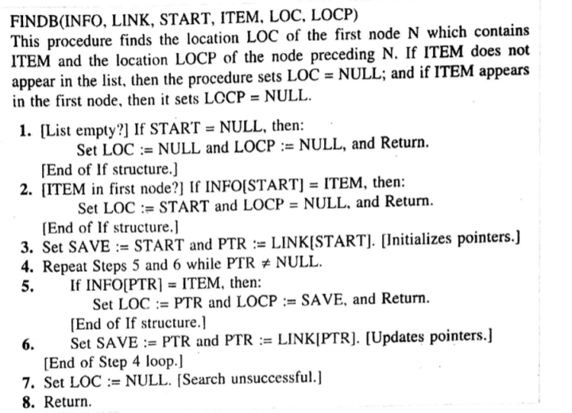
DELETION A NODE WITH GIVEN ITEM OF INFORMATION

Slide 26
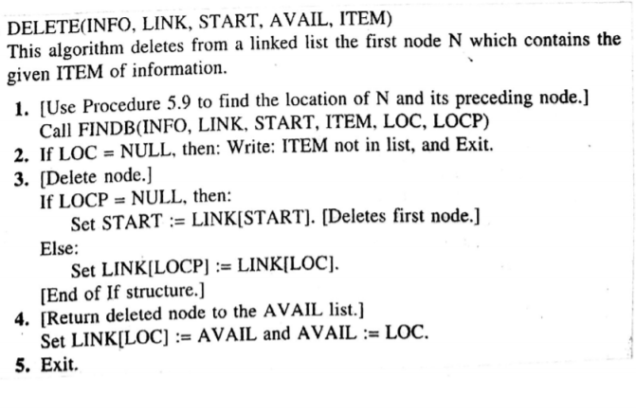
CONTINUED

Slide 27
DOUBLY LINK LISTS
A Doubly Linked List (DLL) contains an extra pointer, typically called previous pointer, together with next pointer and data which are there in singly linked list.

Slide 28
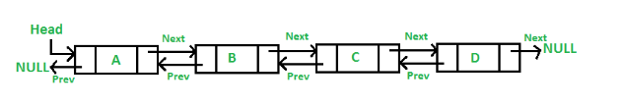
REPRESENTATIONS
[1]

Slide 29
APPLICATIONS OF DOUBLY LINK LIST
Doubly linked list can be used in navigation systems where both front and back navigation is required.
It is used by browsers to implement backward and forward navigation of visited web pages i.e. back and forward button.
It is also used by various application to implement Undo and Redo functionality.

Slide 30
Some important Questions
Q1 How many pointers a doubly link list have?
Q2 “Doubly link list is better than singly link list .” Comment.
Q3 Name any 2 applications of doubly link list

Slide 31
REFERENCES
https://www.cs.cmu.edu/~adamchik/15-121/lectures/Linked%20Lists/linked%20lists.html
https://www.geeksforgeeks.org/data-structures/linked-list/
https://www.tutorialspoint.com/data_structures_algorithms/linked_list_algorithms.htm
https://www.geeksforgeeks.org/merge-two-sorted-lists-place/
https://www.geeksforgeeks.org/reverse-a-linked-list/

Slide 32
Books Recommended
Lipschutz, Seymour, “Data Structures”, Schaum's Outline Series, Tata McGraw Hill.
Gilberg/Forouzan,” Data Structure with C ,Cengage Learning.
Augenstein,Moshe J , Tanenbaum, Aaron M, “Data Structures using C and C++”, Prentice Hall of India.
Aho, Alfred V., Ullman, Jeffrey D., Hopcroft ,John E. “Data Structures and Algorithms”, Addison Wesley.

Slide 33
Queries??

